Slide 1
Our pets-Nasze Zwierzęta Domowe
Kl.IVb

Slide 2
SANDRA Ofman
This is my pet cat
Her name is Pysia
She is 5 months old.
She has got blue eyes and white teeth and small ears.
Her body is ginger
She eat special cat food. She drinks water and milk.
She can run fast
She is very cute
She is my best friend
I usually play with her.
I love my pet❤️🐱

Slide 3
My Dog
This is my pet dog.
His name is Dabi.
He has two years old.
He has dark eyes.
His body is brownish-white.
He eats special dog food. He drinks water.
He can run fast.
He is very cute and funny.
He is my best friend.
Justyna Makowiecka

Slide 4
.
.
Kacper Malinowski

Slide 5
Róża Wiercińska

Slide 6
My Dog
This is my pet dog
Her name is Fafik
She is 4 months old.
She has got brown eyes and big teeth and long ears and long tail.
Her body is black and white.
She eat special dog food. She drinks water.
She can run fast
She is very funny
She is my best friend
I usually play with her.
I love my pet
Maja Żochowiec

Slide 7
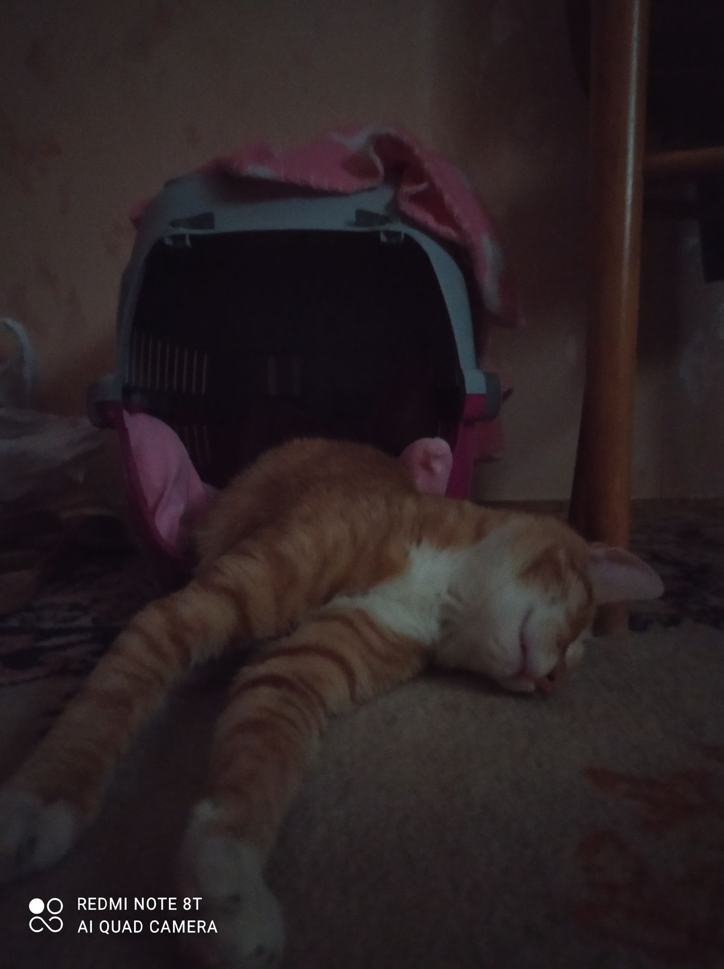
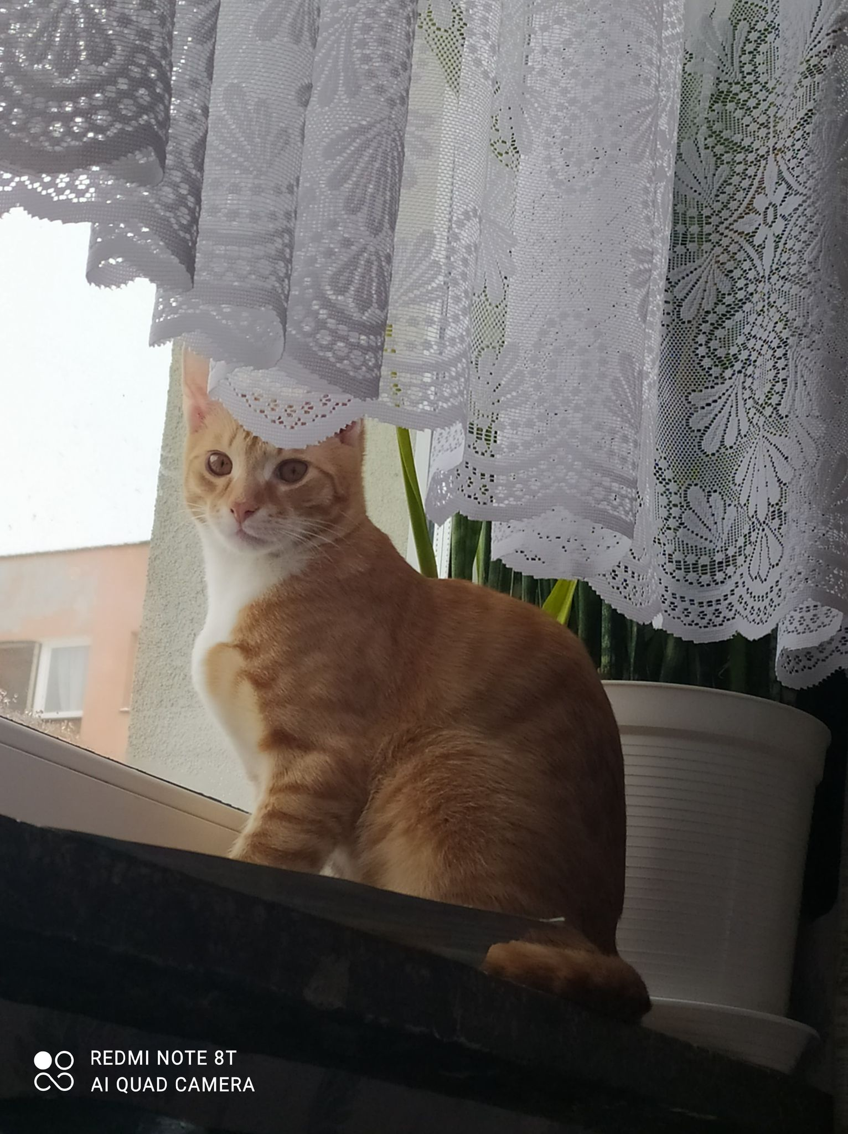
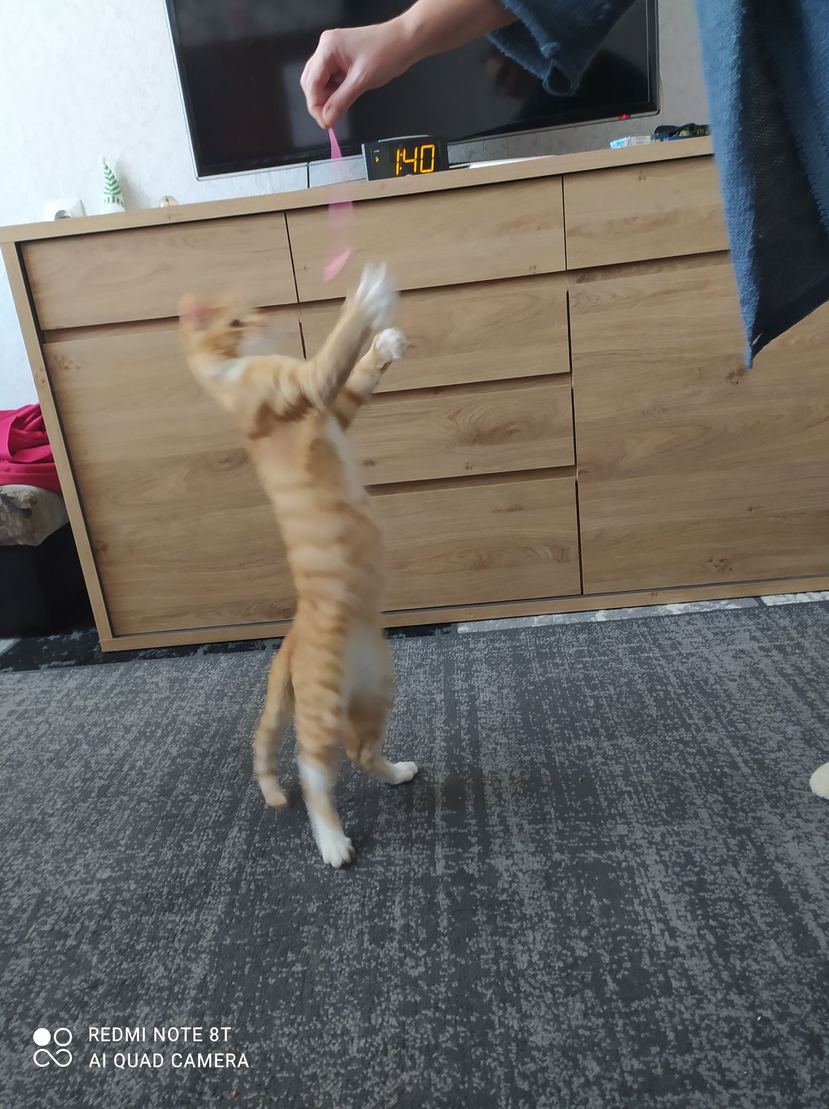
My cat
Zosia Sidorczuk
This is my pet cat
His name is Tosiek
He is 10 months old.
He has orange eyes
His body is ginger.
He eats special cat food. He drinks milk.
He can run fast
He is very cute, funny and friendly
He is my best friend
I love my cat!

Slide 8
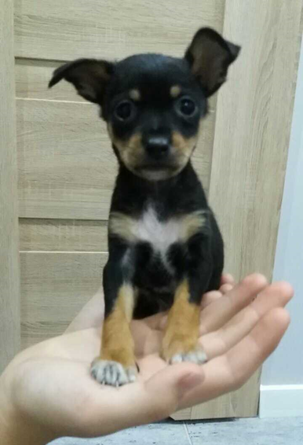
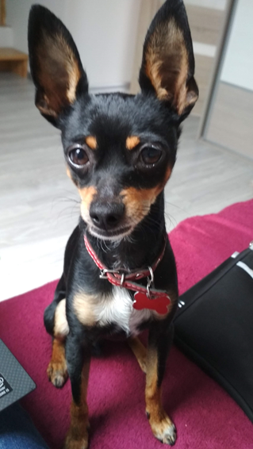
Pixel
This is my pet dog. His name is Pixel. He is 5 years old. He has got brown eyes and small teeth. His body is black and light brown with white spot on his neck. He eats special dog food. He drinks water. He can run fast and swim. He can jump very high and walk on two legs. He is very funny and cute. He is my best friend. I usually play with him. I love my pet.
2021
2016
2021
Karolina Rybak

Slide 9
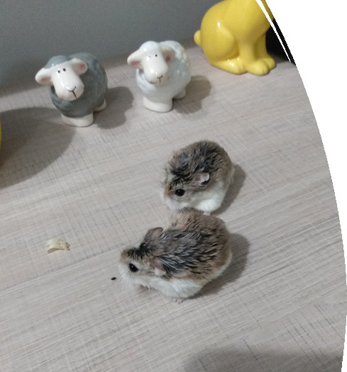
My hamsters
My hamsters are of the Roborowski breed.
They run very fast and they are so small.
They like eating dried or live worms.
Igor Bielenia

Slide 10
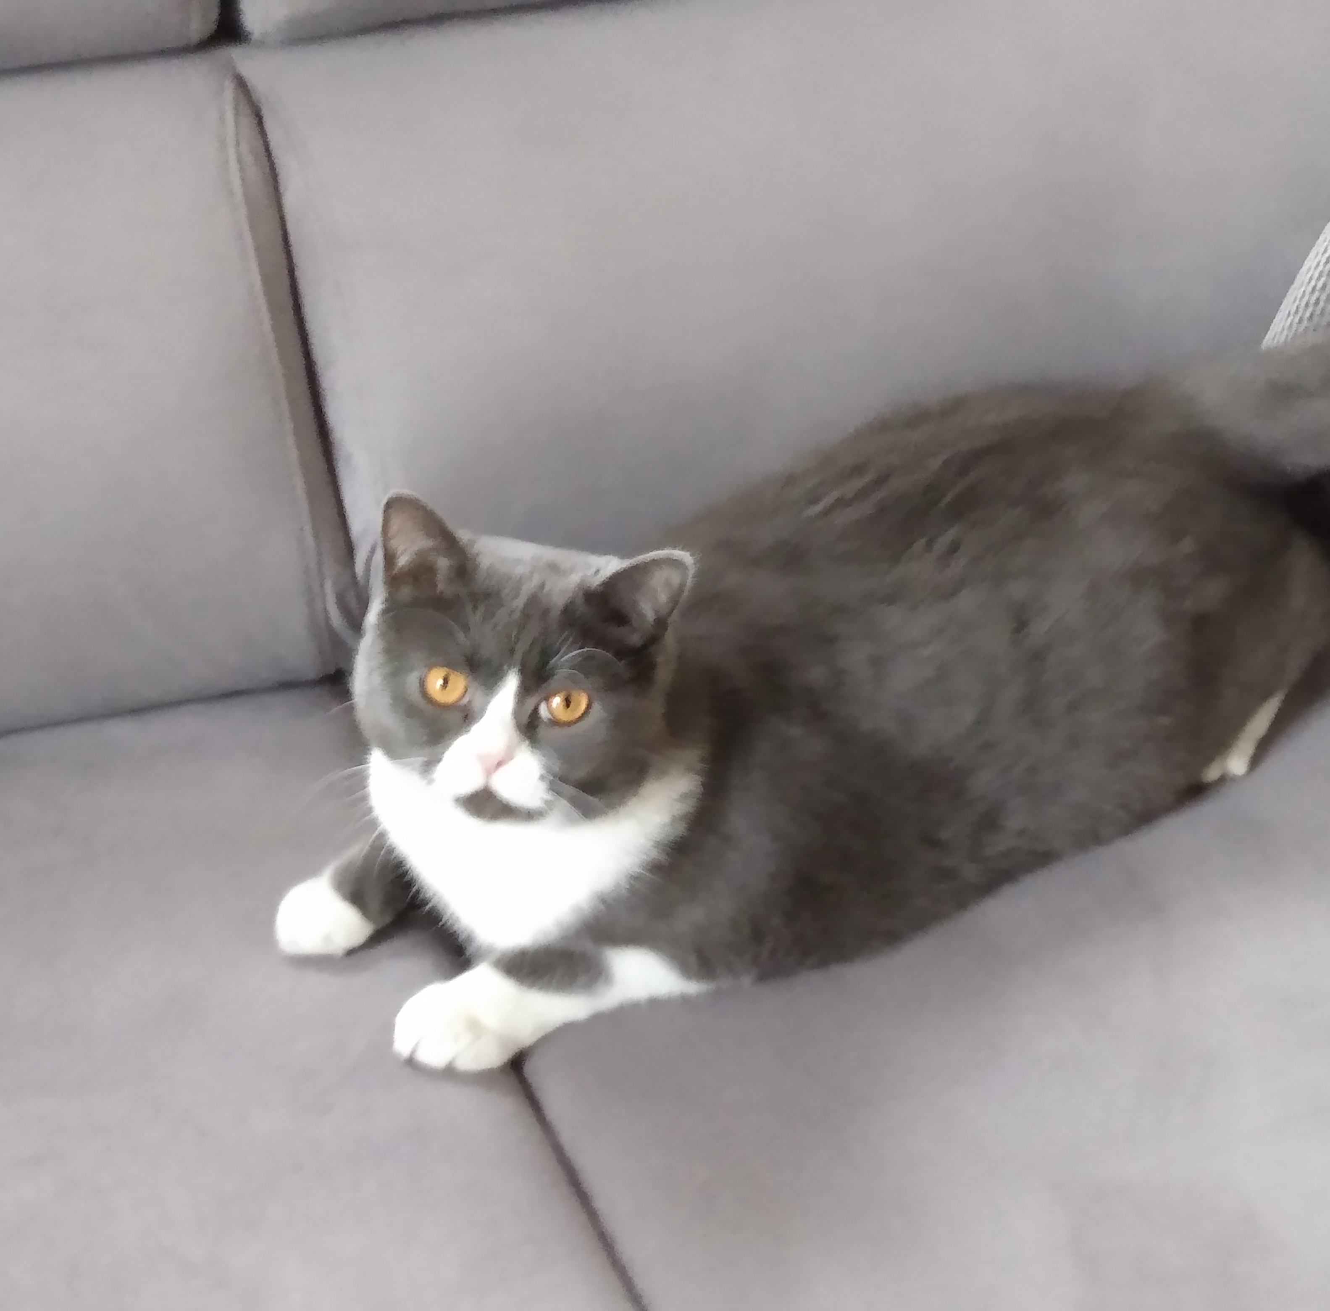
Hi! I'm Igor and this is my pet cat. His name is Psotek. He is a British cat.His delicacy is minced meat.At night he doesn't sleep and plays with hamsters.
My cat
Igor Bielenia

Slide 11
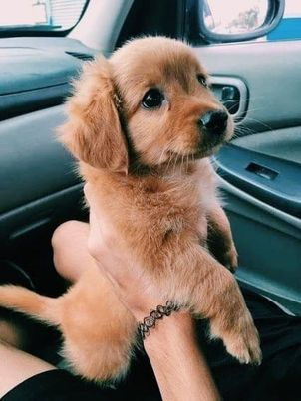
My Dog
This is my pet dog
Her name is Hera
She is 4 months old.
She has got brown eyes and big teeth .
Her body is light brown.
She eats special dog food. She drinks water .
She can run fast.
She is very cute.
She is my best friend.
I usually play and watch tv with her .
I love my pet❤️🐱
Nikola Marunowska

